Slide 1

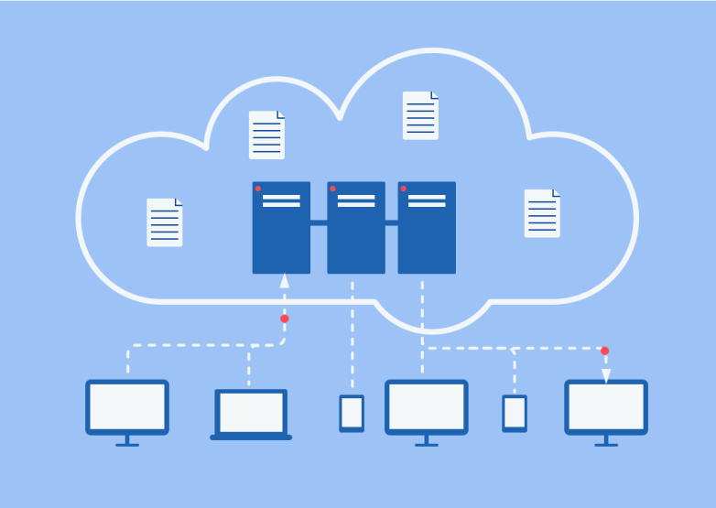
Lab 03 - NAS
https://bit.ly/3vXtJ1O

